Slide 1
How Decision Tree works?
DT Classifier

Slide 2
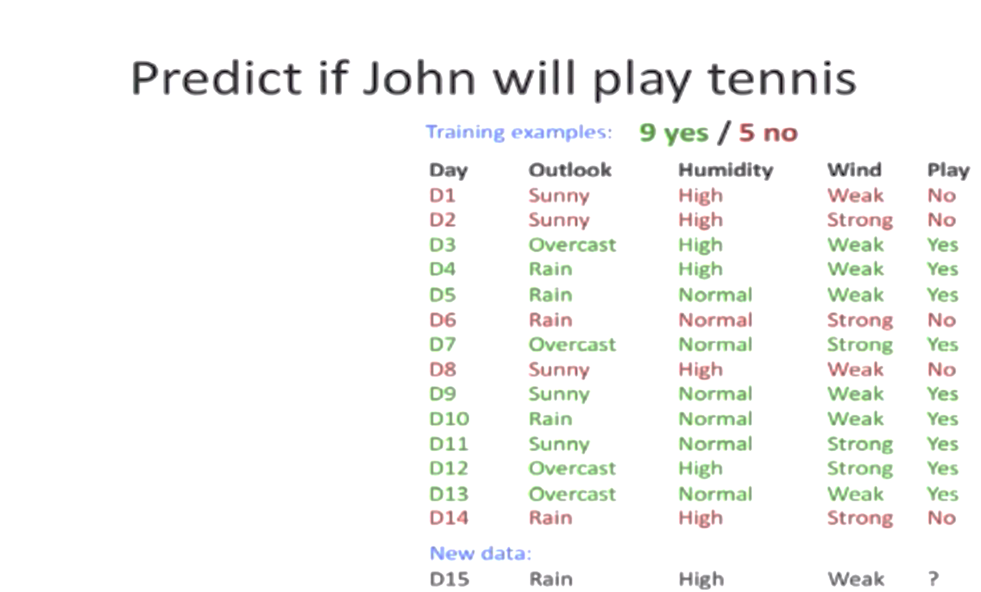

Slide 3
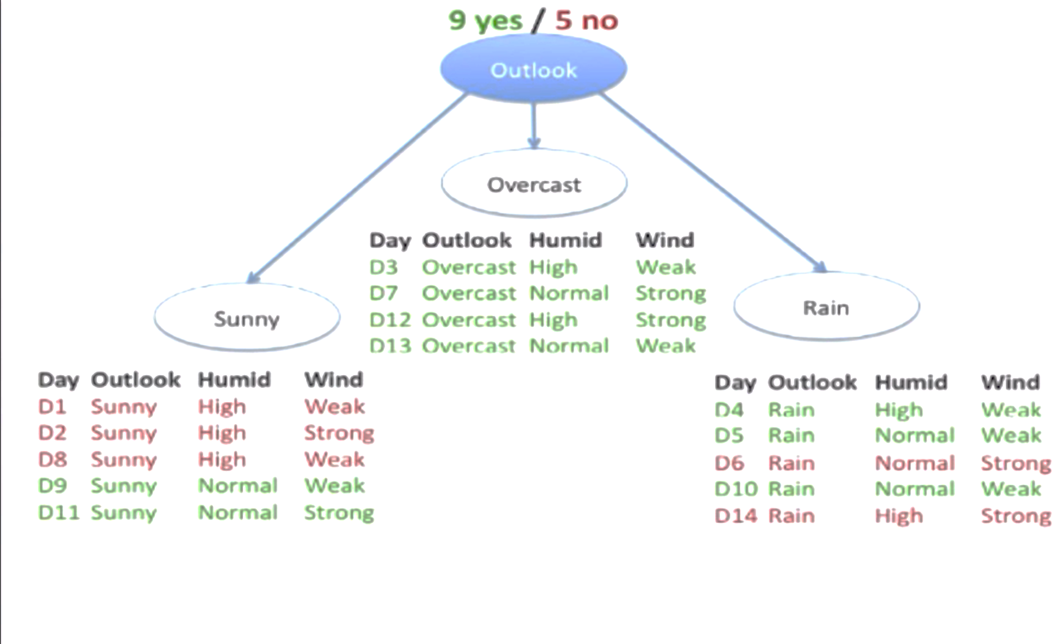

Slide 4
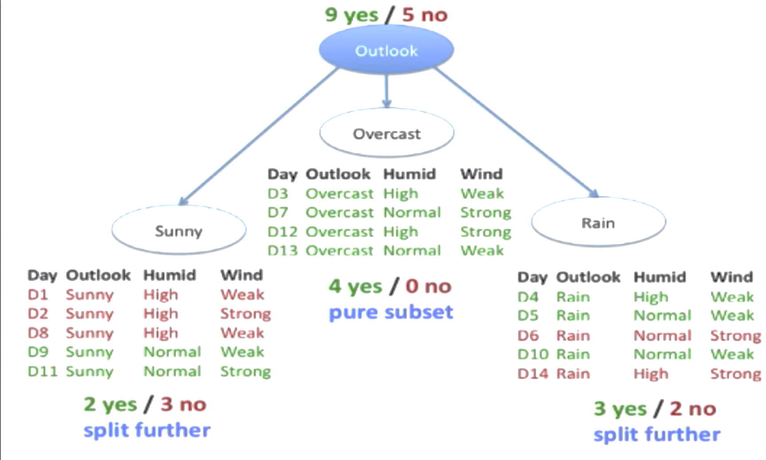

Slide 5
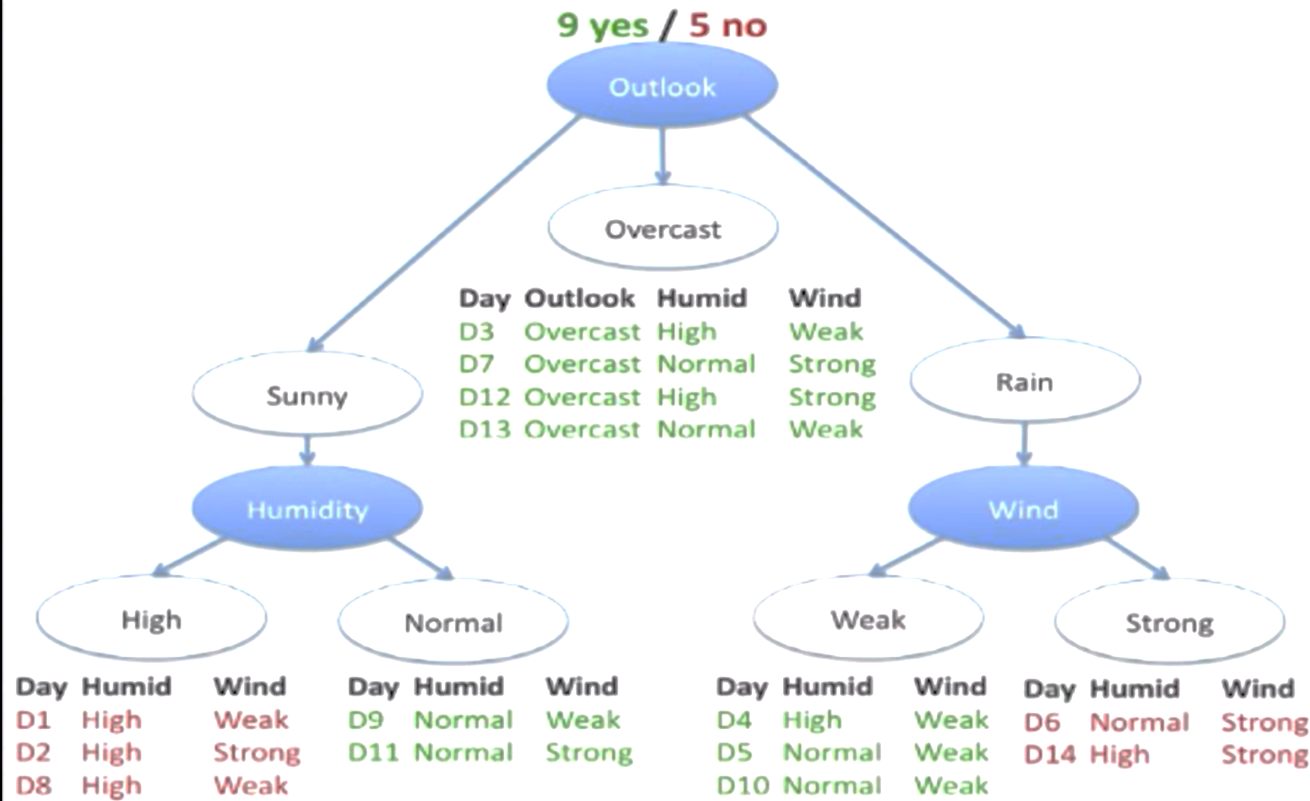

Slide 6
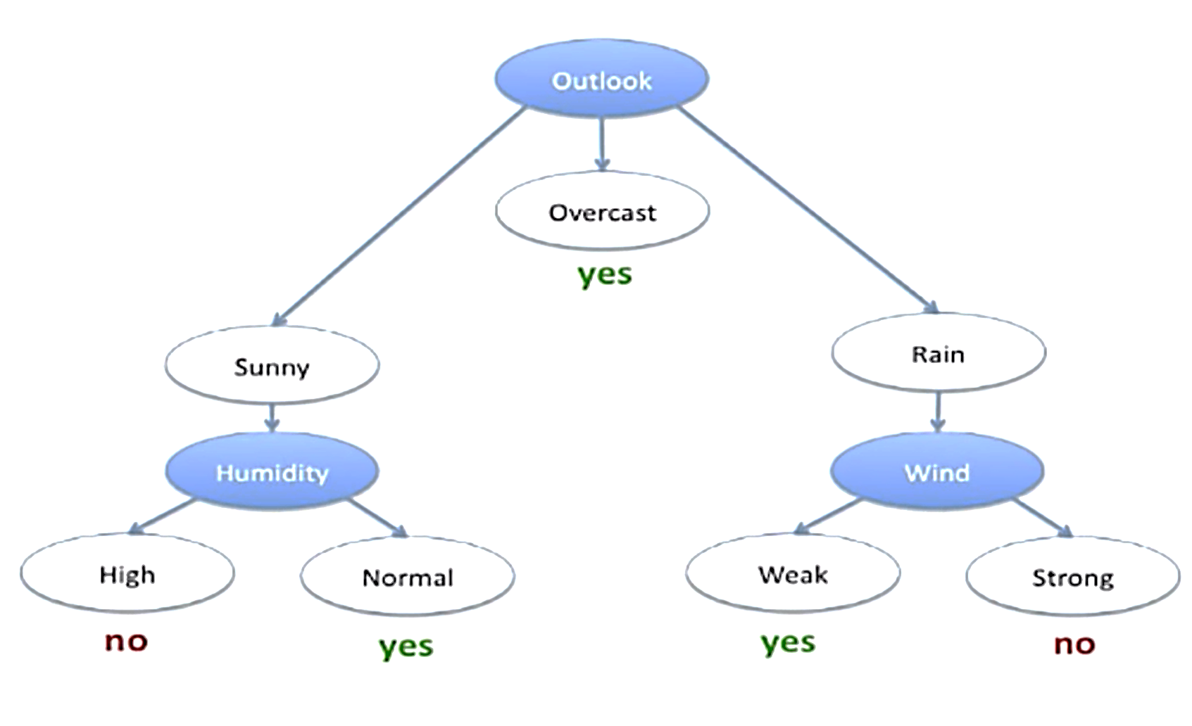

Slide 7
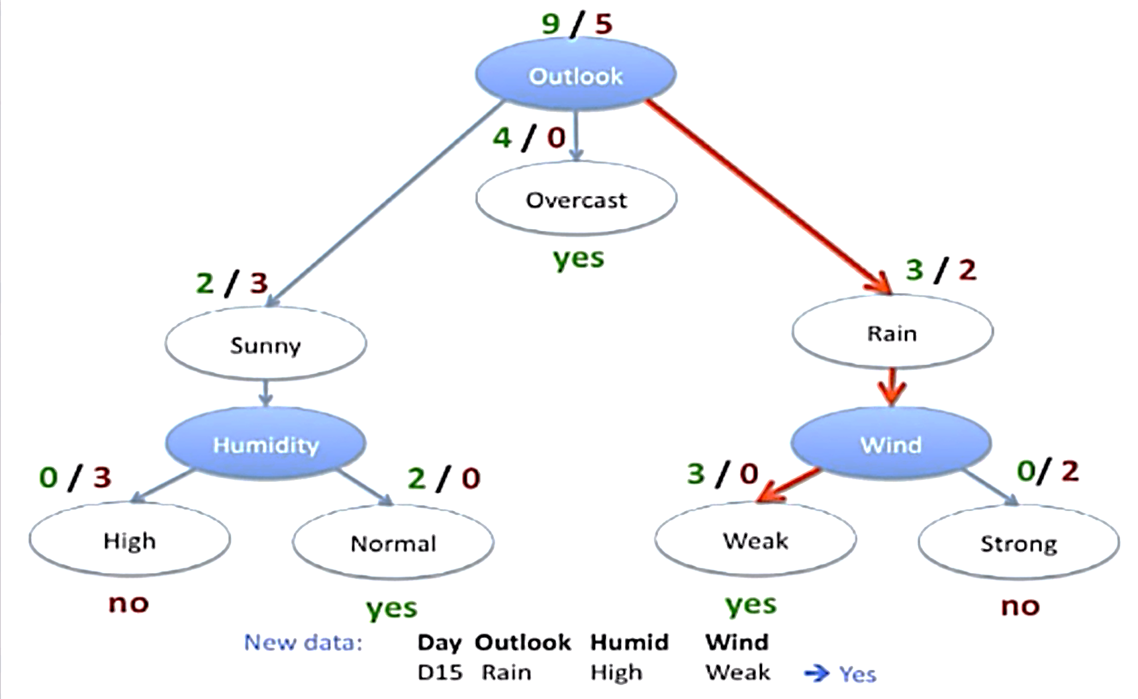

Slide 8
How to select the right feature?

Slide 9
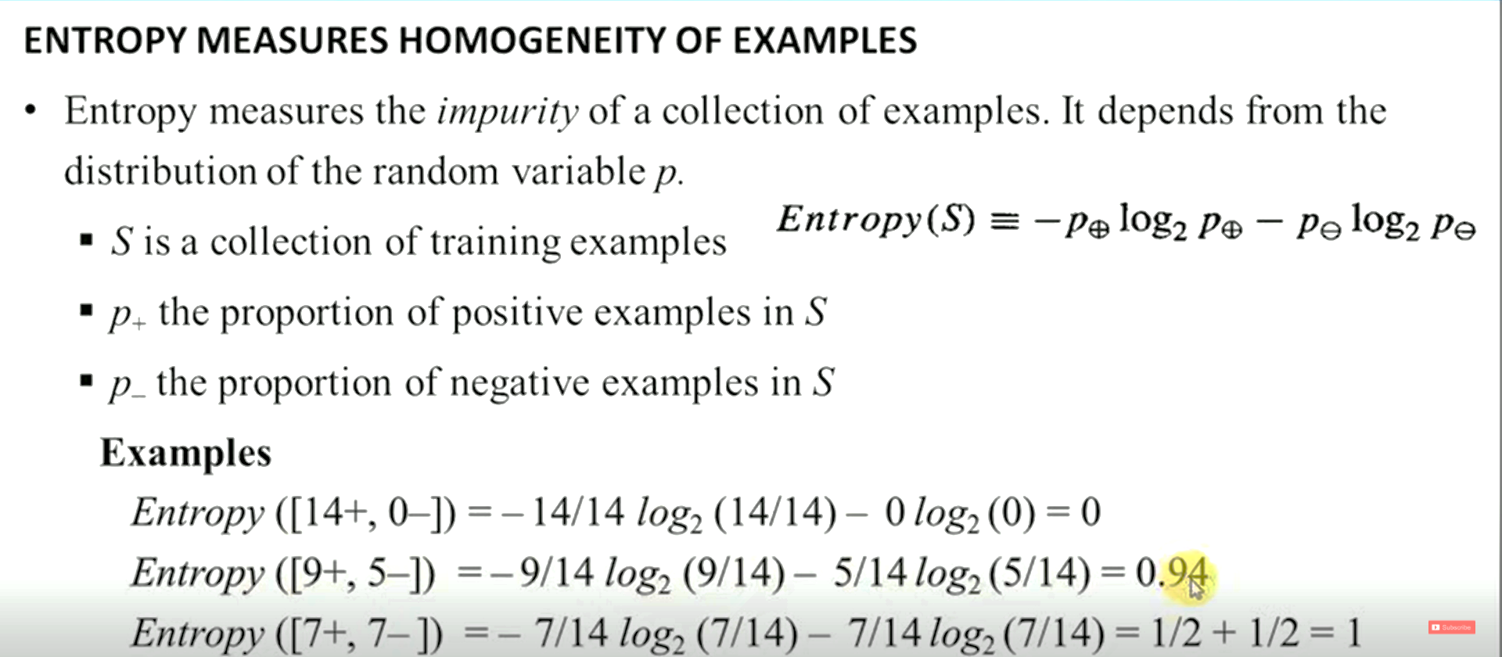

Slide 10
Information Gain:
Information Gain is used to determine which feature/attribute gives us the maximum information about a class.
Information Gain is based on the concept of entropy, which is the degree of uncertainty, impurity or disorder.
Information Gain aims to reduce the level of entropy starting from the root node to the leave nodes.
The greater the reduction in the uncertainty, the more information is gained about Y from X.

Slide 11
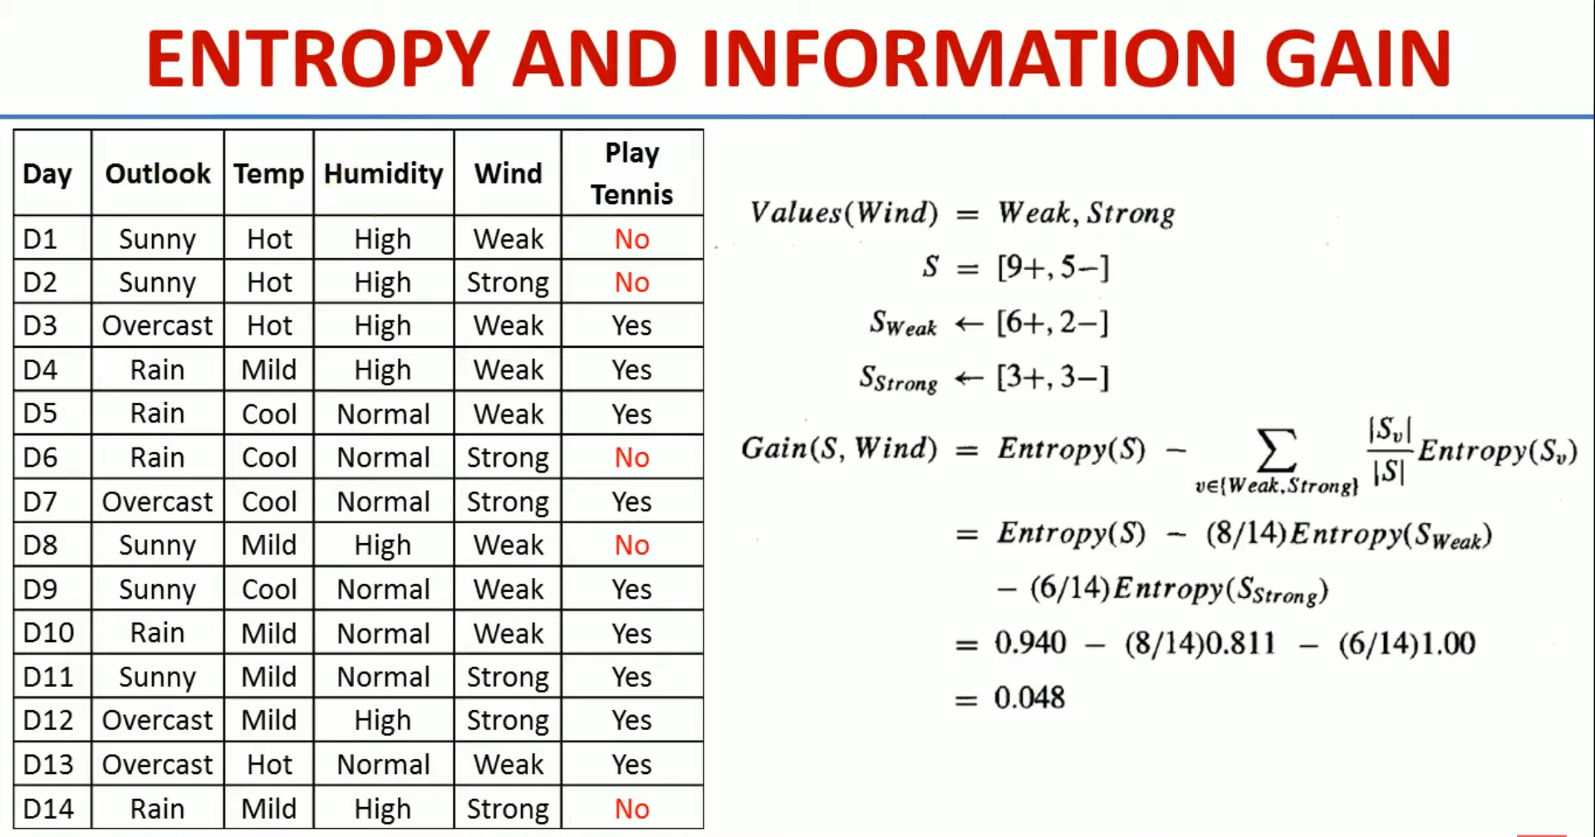

Slide 12
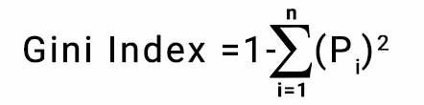
GINI INDEX
Gini index or Gini impurity measures the degree or probability of a particular variable.
4 records → 2 yes, 2 No
Probability of +ve class = 2/4
Probability of –ve class = 2/4
Gini index = 1 – [ sq(p+) + sq(p-) ] = 1 – [ sq(2/4) + sq(2/4) ] = 0.50

